Slide 1















Siloed teams should be a thing of the past, but even in companies that claim to be doing DevOps or agile, some still have a hard separation between product, development, operations, and even QA teams. These hard lines lead to a “throw it over the wall” mentality and make collaboration difficult, and learning tends to stay within each silo. These companies miss out by simply trying to buy their way to success with tools, processes, and frameworks. While tools, frameworks, and processes are important, they can’t compete with a good, supportive culture of learning and collaboration. In this session, you’ll learn how to break down the silos, bring those teams together, and share knowledge which will help you build better software, faster.

Slide 2
How Learning and Collaboration Can Bring Success to Your Projects
Michael Eaton, Principal Consultant @ Improving
Notes:
I am so happy to help kickoff the newly revamped DevOps Cleveland group! When Shaun and Alex reached out to me a few months ago, I knew I wanted to be a part of this!
Thank you, Shaun and Alex for the opportunity
Now, when they first approached me, my first thought was, “I don’t really have any talks that fit in a DevOps-focused group”, but the more I thought about it, the more I realized I DO have something to say.
I sat down to write my abstract (which you can all see on the meetup site) and felt pretty good about it. Once I started working on the details though, I started having more and more things I wanted to talk about, so…here we are.
This is “How Learning and Collaboration Can Bring Success to Your Projects”
When I was first approached by Shaun and Alex, I realized that none of my normal talks would fit, so I started thinking about my experiences over the years and how the best organizations I've been a part of have all shared a common trait - an emphasis on learning and collaboration.
* I've also been doing a lot of thinking (and talking) recently about how we can all get better, not just at our jobs, but life in general. I've done a couple podcasts recently where I talked about the importance of sharing what I've learned.
* I really do thinking learning and collaboration are the keys to success in many areas of life, but for tonight, we're going to talk about them in the context of our jobs.

Slide 3
Married for 26+ years
Father to 2 adult children
Three cats
Developer with almost 30 years of professional experience
Writer / Blogger
Principal Consultant at Improving
Notes:
a little about me - I've been married for almost 27 years, we have two amazing adult children, three cats, and I've been a developer for almost 30 years. I like to write and have a blog, and finally, I'm a Principal Consultant at Improving.

Slide 4



Notes:
The cats...

Slide 5
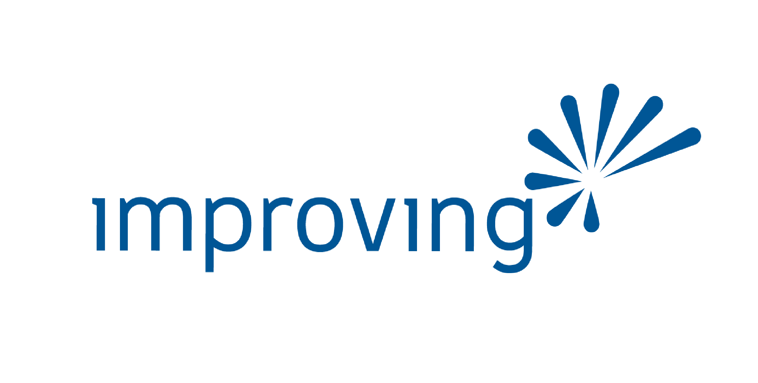

Improving is a modern digital services company that offers IT consulting, software development, and agile training across the globe. Our innovative solutions have helped thousands of our clients realize their tactical and strategic business objectives, allowing them to achieve great new heights in a competitive and ever-changing market.
http://improving.com
Notes:
I also want to thank Improving for not only hosting this meetup, but for being a fantastic employer who does a great job supporting the community, and for encouraging people to get out and speak.

Slide 6
Good
Notes:
Act 2
What separates good companies from bad? What separates bad teams from good?

Slide 7
Culture
Notes:
When I first started working on this talk, one of the words in my abstract that I fixated on was culture.
“a culture of learning and collaboration”
That’s what I want to talk about today
So what is culture?

Slide 8
A set of customs, traditions, values, beliefs, language, and practices that people share in common and that define them as a group or society.​
Notes:
I want to talk a bit about culture…but I want to start at a high level and then drill down…
The dictionary defines culture as “a set of customs, traditions, values, beliefs, language, and practices that people share in common and that define them as a group or society.”
Awesome – great definition.
But we always hear about “company culture” or “agile culture” or “devops culture”, so I want to dig into each of those…

Slide 9
culture in business refers to the combination of shared core values and practices in a company
Notes:
A company culture can refer ”to the combination of shared core values and practices in a company”
Has anyone worked for a company that had a really good culture, one that didn’t feel forced, or worse yet, one that wasn’t toxic?
One company for me jumps straight to the top (sorry, Improving) – and that was Quicken Loans (now known as Rocket Mortgage).
They had a strong company culture, driven from the top by none other than Dan Gilbert, the owner and CEO. Dan’s vision was real, and the culture he created was amazing. As a new team member, it started on Day 1 with something called Kick Start where you learned about the company history, about the ISMs that formed a big part of the culture…a few months later, there was another session where we went deeper into the history and culture and the vision. After that, we had a full day of ISMs, and at the time I was there, that full-day meeting was led by Dan Gilbert himself. It was really cool to experience.
It never felt like “kool aid” to me, but a genuine effort to build something awesome.
We all shared the core values – from Dan on down – all the leadership walked the walk, and talked the talk. Every team member was on board and it was common to hear ISMs dropped if someone slipped.
Ok, so that’s company culture…but what about ”devops culture”?

Slide 10
an approach to organizational change that seeks to bridge traditional divides between teams and establish new processes that facilitate greater collaboration
Notes:
When I asked ChatGPT to describe “DevOps Culture”, it provided me a link to an article that described it like this:
“an approach to organizational change that seeks to bridge traditional divides between teams and establish new processes that facilitate great collaboration”
Ooooh….what’s not to like about that one?
Ok, so what about “agile culture” – what do we mean when we talk about that?

Slide 11
At its most basic, an Agile culture is a way of working where people focus on the Agile principles and values. It’s a culture that promotes cross-functional collaboration, practices customer-centricity, focuses on outcomes over outputs, experiments regularly, and makes decisions based on data, not opinions
Notes:
“at its most basic, an Agile culture is a way of working where people focus on the Agile principles and values”
Ok…
“It’s a culture that promots cross-functional collaboration, practices customer-centricity, focuses on outcomes over outputs, experiments regularly, and makes decisions based on data, not opinions.”
If you’re familiar with the manifesto – the principles and values, you’ll know it’s all about collaboration and learning

Slide 12
Learning is…
Notes:
Act 1
Learning is the process by which individuals acquire knowledge, skills, attitudes, or behaviors through study, experience, or teaching.

Slide 13
Collaboration is…
Notes:
Act 1
Collaboration refers to working together with others to achieve a common goal or solve a problem.

Slide 14
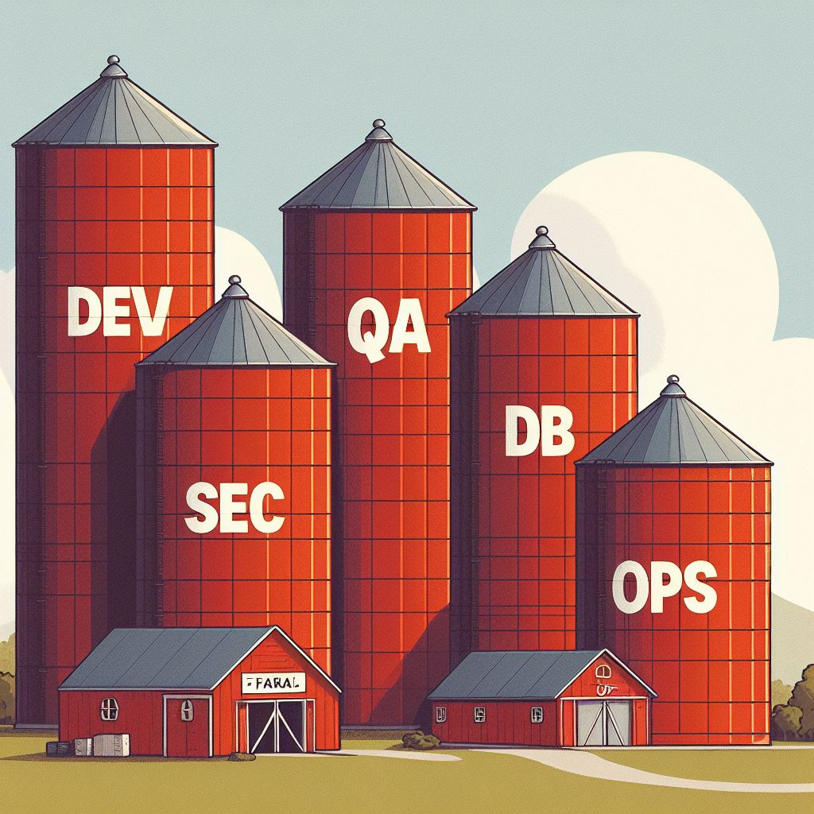

Slide 15
Challenges
Notes:
So, today, what challenges do we have to deal with to get our code tested and deployed?
In some cases, not much – we, as developers, simply push our code to a repository where pipelines build it, test it, and deploy it.
I don’t know a single developer who doesn’t dream about actually doing continuous deployment to production, but that’s harder than it looks.

Slide 16
Some history…
Notes:
Act 1
When I look back over almost 30 years of professional software development, I’ve worked for some great organizations and some not-so-great organizations.
The great ones all shared a common trait – they all put an emphasis on learning and collaboration, something I believe is key to success in projects of all kinds.
Before we dive in, I want to take you all back to a different time – maybe some of you will remember what it was like before “agile” and “devops” and the cloud. It was a different time for sure.
I want to take you back for a minute or two - back to the dark ages of the mid-90s. Looking around, I'm sure many of you got your start around the same time...well, except for Joe...he's old enough to remember coding with a hammer and chisel...
* Anyway, when I started, the teams within the IT umbrella were separate and distinct.
* The coders wrote code
* The QA testers took the code that was thrown over the wall at them and tested it, throwing back bug reports. They had written test plans, sometimes printed and in binders, sometimes in spreadsheets, but regardless, they were step-by-step instructions for how to test each and every piece of what we created.
* The server team had server guys and network guys. The server guys would help spec out the servers we needed for our database or applications. They would also be the people who would put the server(s) in racks in on-prem datacenters. Oh, and once the servers were installed, they acted as the admins, installing the necessary software, applying patches, creating users...and never letting us lowly devs have much access. The network people would run cable and connect the machines to the network. They also tended to do "security stuff" because, you know...the internet.
* Speaking of databases, there also tended to be a team of DBAs who would either create the schema and objects or would take the scripts we as developers wrote and execute them on the server. Need data from a server? Ask the DBA and they'll run a query. Want production access? DENIED. Good, I didn't want it anyway.

Slide 17
Current state?
Notes:
Act 1
Fast forward a few years as agile started to infiltrate work places and things started to change. Then came the cloud with its significant shift in how we think and work. Things are certainly better now, but not perfect. I still run into organizations who have broken down the big silos, but who have created new silos…Now what I see are project teams that consist of developers and qa. More ownership has been brought to the teams, but it's limited.
Now we have a DevOps team with people who are responsible for the infrastructure of our applications…need a server? Ask, and one of them will spin one up in one of the cloud services we all know and love. Need networking or security configured? One of them will do it. Even things that seem like they should be solidly in the world of developers, if you need a pipeline, they will create it.
- Oh, and those people from the DevOps team are almost never dedicated to your team, so things take time. If they're not organized, sometime your requests get lost. They also almost always have other, more important, stuff to work on.
- Once they've created your infrastructure, they tend to still be in control…it's rare that the teams I've been on have been given access to the portal. It's not that it never happens, it's just rare…
- It's not like I necessarily *want* all the access, it's just that I don't want to have to wait until the DevOps engineer can work me into their schedule. Same if there's any database involved...it seems like there's always a database team who wants to be the ones to run all schema updates and queries
- Also, I've seen DevOps engineers create templates and pipelines and NEVER have them reviewed by anyone else. Can you imagine writing code and pushing it straight to main and deploying it without any kind of review? For some reason, these teams think it's ok.
- I've been on teams that had working pipelines one day and broken the next because a DevOps engineer made a change but didn't tell anyone, and when asked, they denied it was them. Ok…well, it certainly wasn't US!
- What's wrong with what I just described?
BTW, some teams have it right though, and we'll talk about that as we go through the rest of the talk.

Slide 18
How are we doing?

Slide 19
Challenges
Notes:
Act 3
Staff
Too much work and too few people
Too few DevOps people to support the teams

Slide 20
Office hours
Notes:
Act 3

Slide 21
What can we do?

Slide 22
Build and nurture a great culture

Slide 23
Purpose, Goals, and a Vision
Notes:
Act 3
Have learning be a part of your goals and vision. Don’t just leave it up to people and teams to do it when they have time

Slide 24
Prioritize Communication and Transparency
Notes:
Act 3
Clear Communication Channels:
Establish channels for sharing information, updates, and decisions. Regularly communicate company news, strategic shifts, and progress toward goals.
Use a mix of methods: team meetings, newsletters, intranet platforms, and one-on-one conversations.
Share the “Why” Behind Decisions:
When making significant decisions, explain the rationale behind them. Employees appreciate understanding the context and reasoning.
Transparency builds trust and reduces uncertainty.
Feedback Loops:
Encourage open feedback from employees. Create a safe space where they can express opinions, concerns, and suggestions.
Regularly seek input on processes, policies, and workplace dynamics.
Leadership Transparency:
Leaders should model transparency. Share their own challenges, learnings, and decision-making processes.
Avoid surprises; keep employees informed about changes or challenges.
Financial Transparency:
While not all financial details need to be public, provide clarity on overall company health, revenue, and profitability.
Transparency around compensation, bonuses, and benefits is also crucial.
Performance Metrics and Goals:
Clearly define performance metrics and individual/team goals. Regularly review progress.
Transparency in performance evaluations fosters a growth mindset.
Conflict Resolution:
Address conflicts openly and constructively. Encourage dialogue rather than avoidance.
Transparency helps resolve issues before they escalate.
Celebrate Wins and Learn from Failures:
Share successes with the entire team. Acknowledge individual and collective achievements.
Equally important, discuss failures and lessons learned. Transparency around setbacks promotes a culture of continuous improvement.
Employee Surveys and Pulse Checks:
Conduct anonymous surveys to gauge employee satisfaction, engagement, and well-being.
Use the insights to make informed cultural adjustments.
Accessibility to Leadership:

Slide 25
Be positive
Notes:
Act 3

Slide 26
Give people the time
Notes:
Act 3

Slide 27
Lead by example
Notes:
Act 3

Slide 28
Share
Notes:
Act 3

Slide 29
Office hours
Notes:
Act 3

Slide 30
Find and reward cultural champions
Notes:
Act 3

Slide 31
Build and nurture a great culture

Slide 32
Focus on learning

Slide 33
Focus on sharing

Slide 34
Focus on collaboration

Slide 35
Questions?

Slide 36

THANK YOU
Michael Eaton
michael.eaton@improving.com
mjeaton@hey.com https://samestuffdifferentday.net/about

